Slide 1
NEED to Know- Evidence Handling
01/23/19

Slide 2
Roadmap
MIDNs Haines and Johnson present &discuss.
Need to know – evidence handling
Lab Assignment 2- Autopsy investigations
Friday:
Evidence acquisition (first half)
Team project (by Friday)
Assignment of the team project
4 MIDNs in a team
Know your other team members before Friday
Nominate a Team leader and Assistant leader
Please upload a Word document into whichever team you choose.

Slide 3

Our main concern when acquiring evidence
 To preserve digital way in a way that:
Maintains an accurate representation of the original data, and
Maximizes its usefulness for decision makers, i.e., it is as
complete as possible
 Simply put:
We want to get the most evidence we can with the least amount of alteration

Slide 4
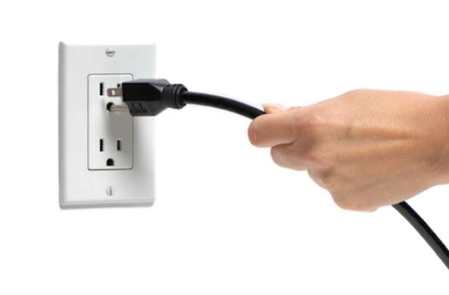
Dilemma: To pull the power plug or not

In the past, most computer forensics experts recommended pulling the power cable on a computer right away, even if the computer is running
 Most experts agreed that you should not go to any extraordinary efforts to gather volatile data stored in RAM
10

Slide 5
Advantages of pulling the power plug
 May help preserve evidence, for example:
 Any script the suspect has written that should execute upon shut-down doesn't get a chance to run
 Temporary word-processing and other interim files remain on the hard drive, whereas they might get deleted if the software applications shut down more gracefully

Slide 6
Pulling the power plug
 Information may be lost by virtue of the volatility of data
 Computers have large amounts of RAM which maintain process context information, network state information, and much more
 Once a system is powered down, the immediate contents of that memory are lost and can never be completely recovered
 Examples:
 On a suspect’s computer there is a important message stored in RAM that will be lost if the computer is unplugged
 In network intrusions, it is usually desirable to capture information related to active processes and malware resident in memory

Slide 7
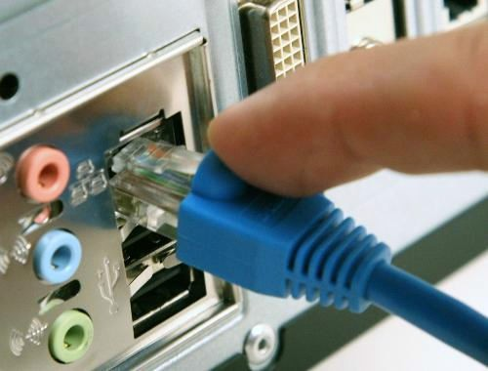
A similar dilemma: Unplugging the network cable
 To prevent anyone from accessing systems from outside the crime scene, it is generally advisable to disable network connectivity to all computer systems
 However, this action can destroy evidence and eliminate investigative opportunities

Slide 8
Problems with disconnecting the network cable
 The opportunity to list the active connections to the system is lost: investigators may never know which other computers on the network might contain evidence
 In certain cases such as network intrusions, disconnecting network connections may eliminate an opportunity to gather network traffic of the perpetrator in action
 Furthermore, it can seriously impact a business: disconnecting an e-mail server or an e-commerce site’s main transaction server can cause significant losses

Slide 9
Risk assessment necessary before live capture
 A risk assessment must be undertaken at the point of seizure to assess whether to capture live data which could significantly influence an investigation
 It may be worthwhile considering manual closure of various applications, but requires expert knowledge
 Closing Microsoft Internet Explorer will flush data to the hard drive, thus benefitting the investigation and avoiding data loss

Slide 10






































Preserving computer evidence: decisions
Identify computer system, secure scene, and preserve trace evidence
Keep it off!
no yes
no
Computer on?
Screen saver?
yes
Photograph, label, document, disconnect network, power cables. Collect peripherals, removable media, etc.
Move mouse
Disconnect power
yes
no
Password
prompt?
yes
Destruction in progress?
yes
no
Collect digital evidence that is needed
no
Document screen, system time, and network activity. Preserve volatile data if needed
Computer required?

Slide 11
Autopsy investigation
What are we looking for?
Digital artifacts
that which is left behind based upon the activities of the end user of the device – footprints
Examples:
Videos, documents, audio recordings, emails, photos
Location data, social circles, cached content, communications data
Backup archives, web activity logs, configuration files, access control logs

Slide 12
Potential digital evidence by crime category
 Two examples, from A Guide for First Responders, by USDJ
 https://www.ncjrs.gov/pdffiles1/nij/219941.pdf
Category Potential digital evidence
Software piracy Computers. Handheld mobile devices. Removable media. External data storage devices. Information regarding chat sessions. Information on cracking software. Printed e-mail, notes, and letters. References to copyrighted software. Forged software certificates. Lists of software activation codes. Information regarding Internet activity. Software duplication and packing material.
Domestic Computers. Removable media. User names and accounts. External violence, threats, data storage devices. Mobile communication devices.Telephone and extortion records. PDAs or address books. Financial or asset records. Personal writings and diaries. Information regarding Internet activity. Printed e- mail, notes, and letters. Legal documents. Caller ID units.
12

Slide 13
Bottom-line
You need to know what possible artifacts to look for.

